Slide 1
Users Microservice - A Quick Start

Slide 2
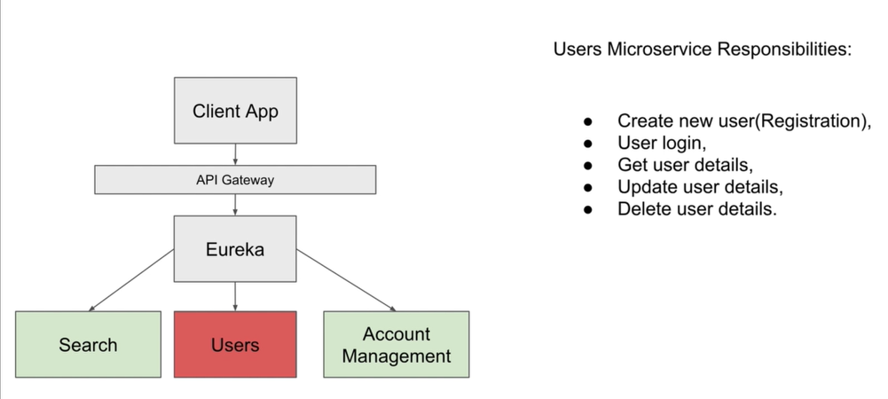

Slide 3
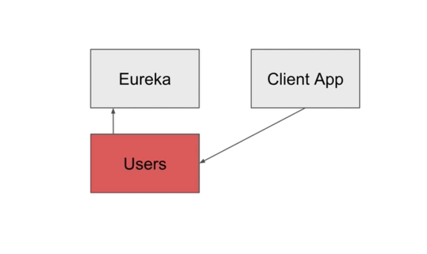

Slide 4
Users Microservice - Create new Spring Boot Project

Slide 5
